Slide 1

BERT - Experiments

Slide 2
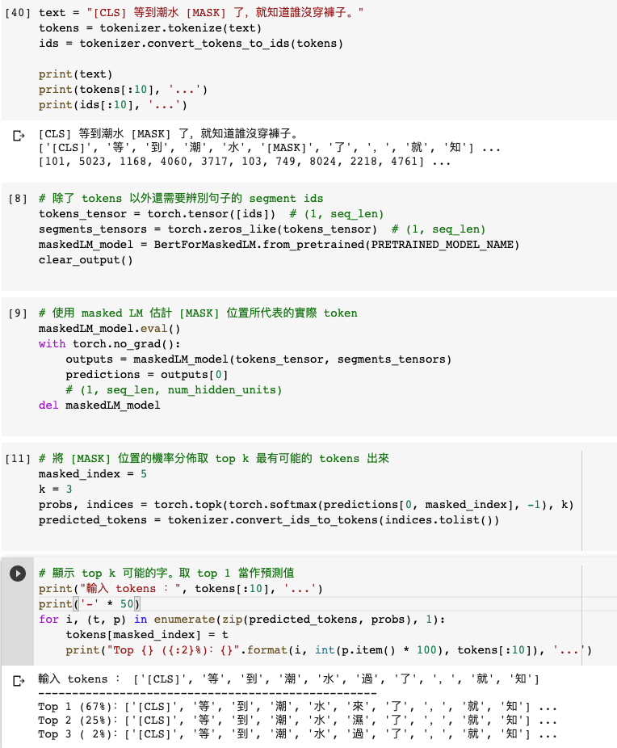
Masked Language Model (MLM)

Slide 3
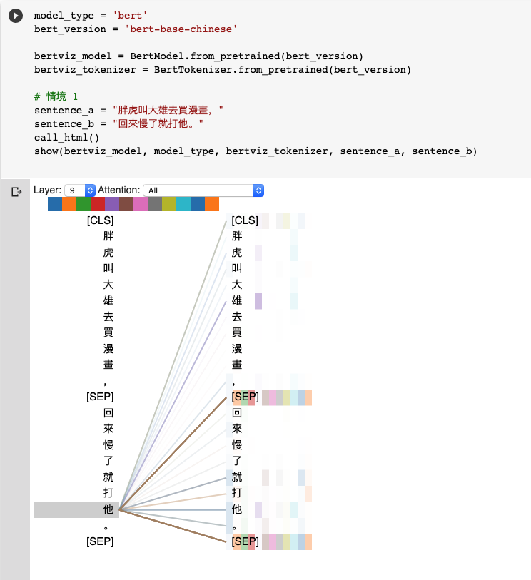
Natural Language Inference (NLI)
Attention Visualization

Slide 4
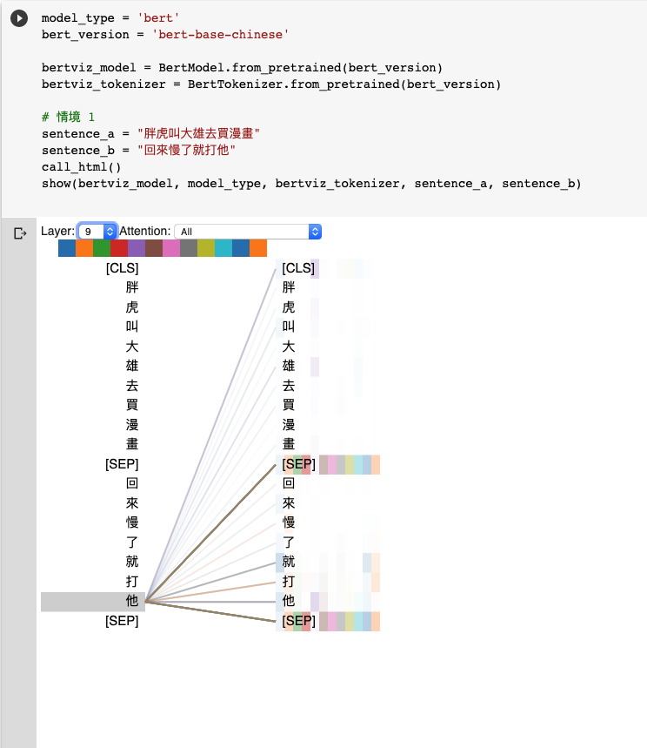
Natural Language Inference (NLI)
Attention Visualization

Slide 5
Source Code Analysis

Slide 6
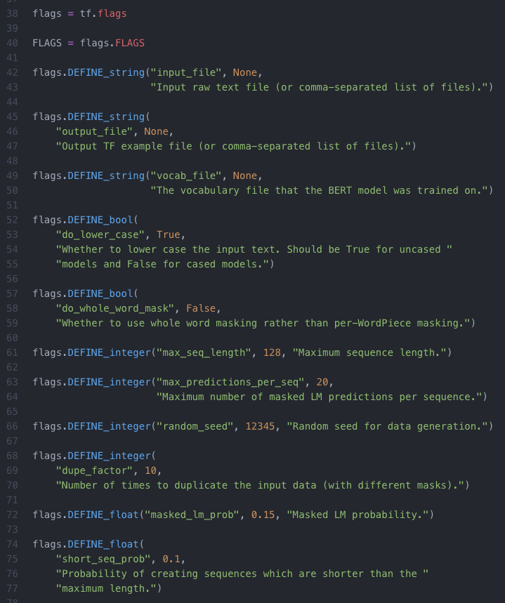
input_file
output_file
vocab_file：Path of Dictionary (Provider: Google Inc.)
do_lower_case: If ‘Ture’, ignore uppercase.
max_seq_length：Length of single sequence, which includes 2 sentences
max_predictions_per_seq：Maximum masks per sequence
random_seed：random seed
dupe_factor：Random selection times from input file
masked_lm_prob：Prob of masks from single sequence
max_predictions_per_seq*masked_lm_prob
short_seq_prob：To minimum loss between pre-training and fine-tune, use this prob to generate those sequences which are shorter than max_seq_length

Slide 7
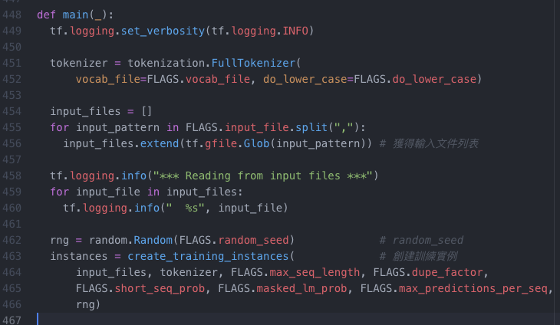
create_pretraining_data.py
modeling.py
run_pretraining.py
create_training_instances
Devlin, Jacob, et al. "Bert: Pre-training of deep bidirectional transformers for language understanding." arXiv preprint arXiv:1810.04805 (2018).

Slide 8
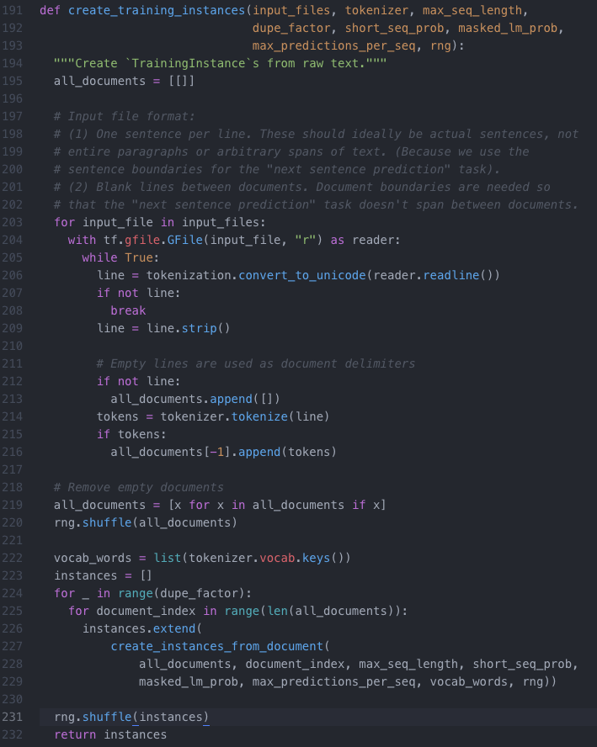
Input File Format Restriction
Pre-training
Tokenization
tokenization

Slide 9
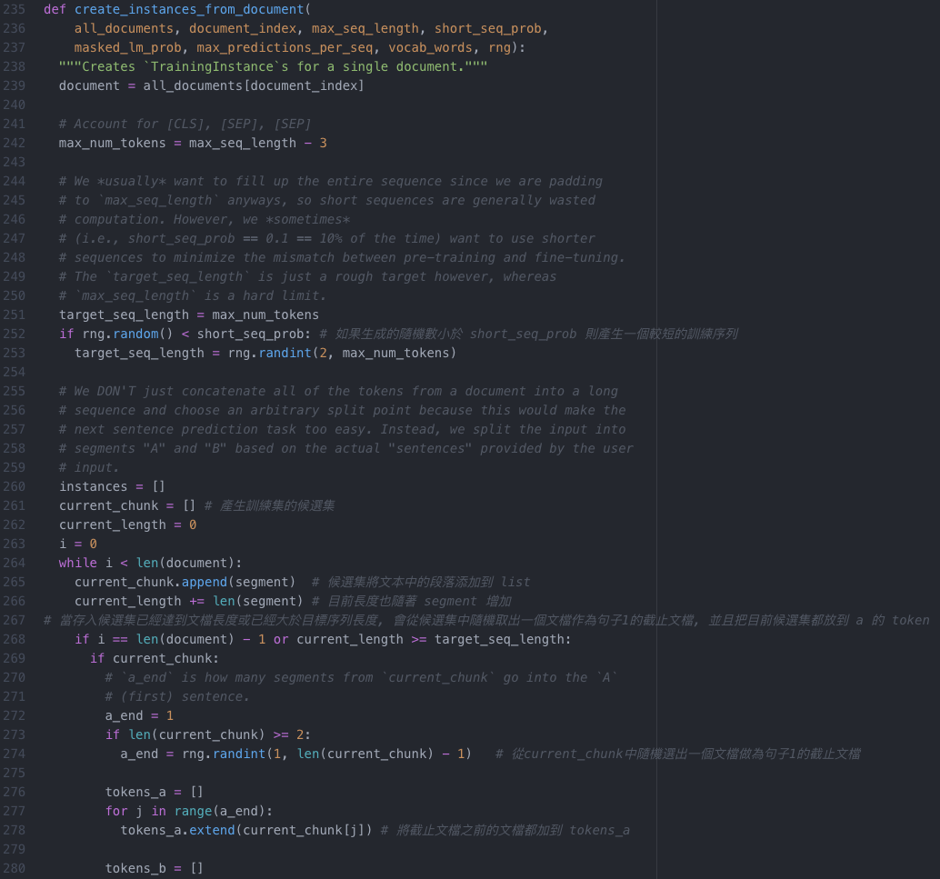
[CLS], [SEP], [SEP]
Pre-training
Next Sentence Prediction (NSP)
short_seq_prob
current_chunk
current_chunk
token
current_chunk
token

Slide 10
ELMo, BERT, GPT

Slide 11
Word Embedding
One-Hot-Encoding
Bag-of-Words (BoW)
一詞多義
1 type 1 embedding
1 type 固定數量的 embedding
每個 token 不同的embedding
Contextualized Word Embedding

Slide 12
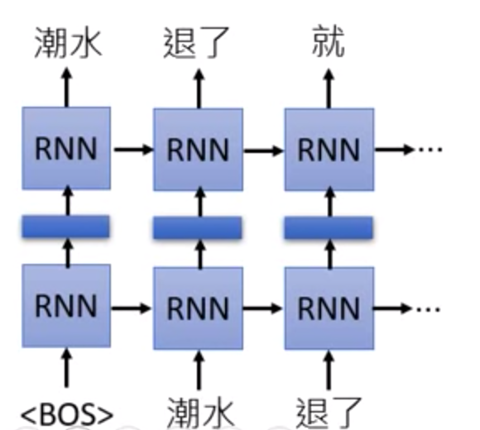
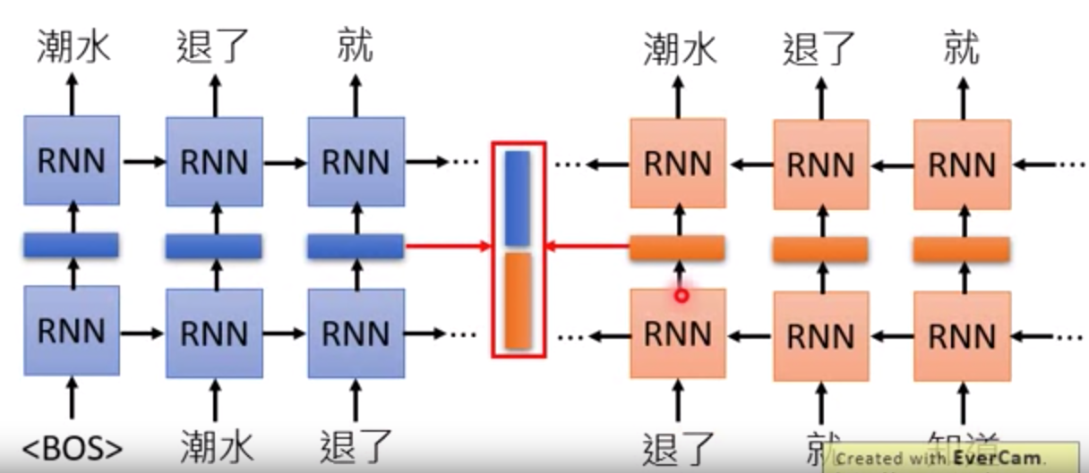
Embedding from Language Model (ELMo)
RNN-based Language Model: 蒐集未標註的句子, 再由RNN訓練
只考慮到左側上文

Slide 13
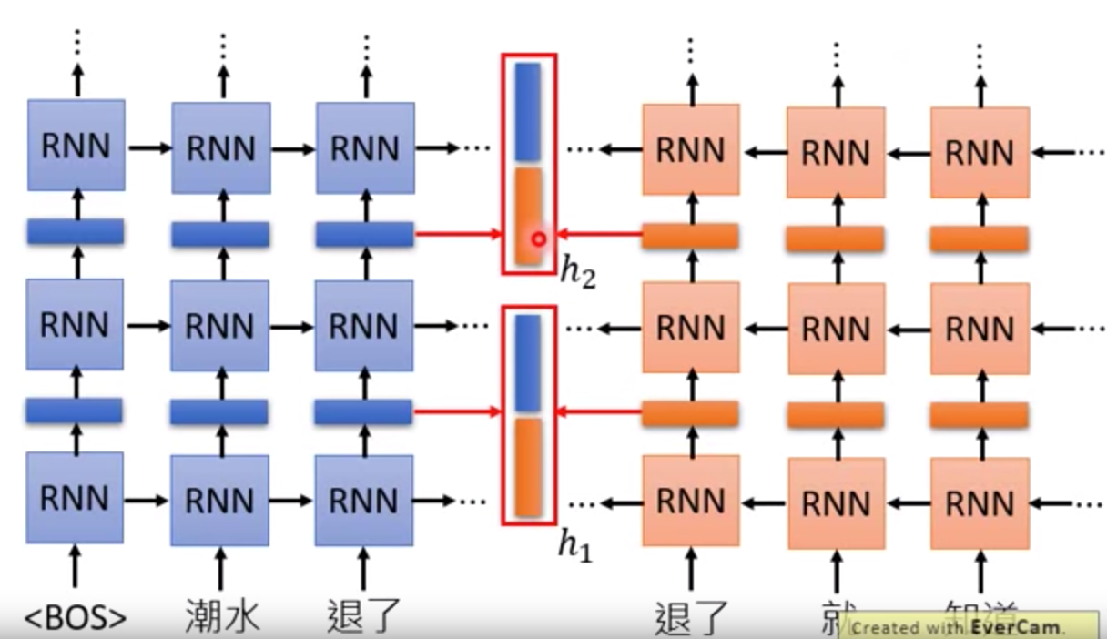
Embedding from Language Model (ELMo)

Slide 14
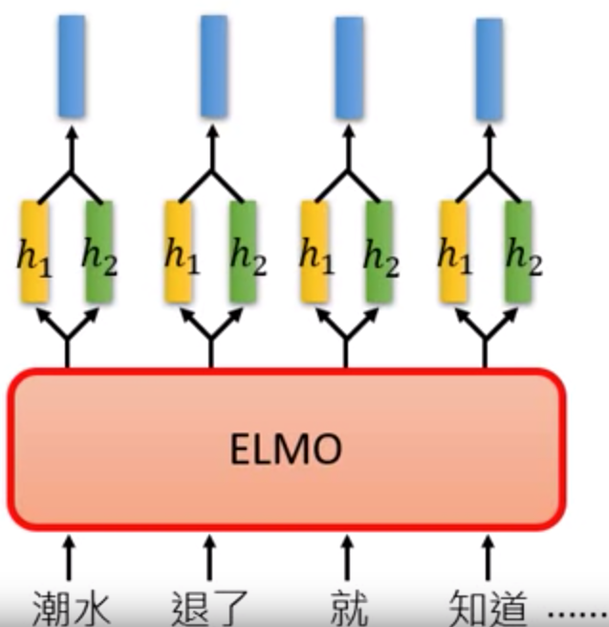
Embedding from Language Model (ELMo)

Slide 15
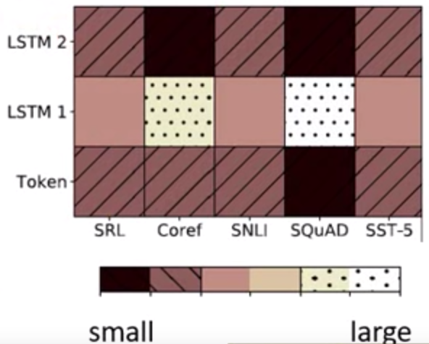
Embedding from Language Model (ELMo)

Slide 16
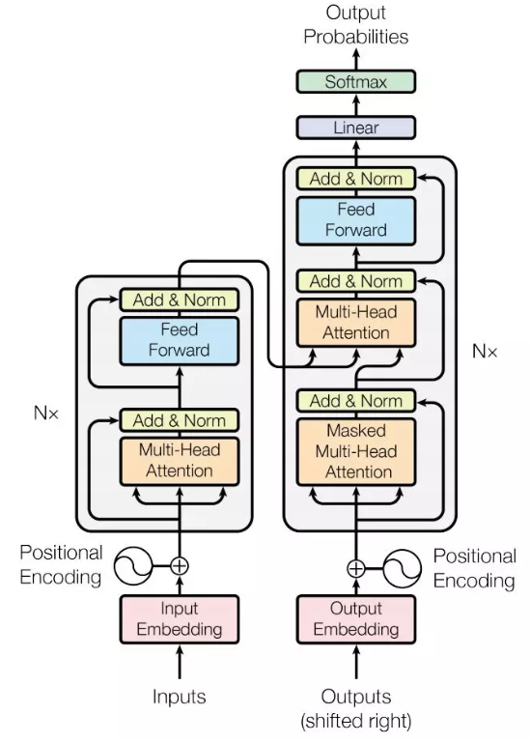
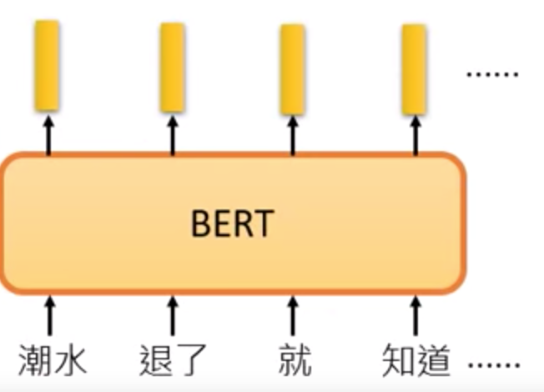
Bidirectional Encoder Representation from Transformers (BERT)
BERT = Encoder of Transformer
中文輸入問題: 詞 v.s.字
Devlin, Jacob, et al. "Bert: Pre-training of deep bidirectional transformers for language understanding." arXiv preprint arXiv:1810.04805 (2018).

Slide 17
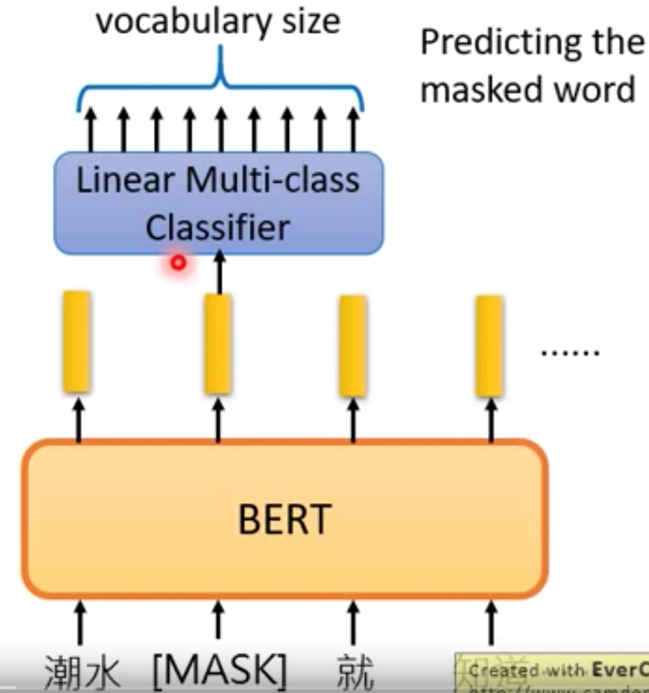
Bidirectional Encoder Representation from Transformers (BERT)
Pre-training
Masked Language Model (MLM)
Devlin, Jacob, et al. "Bert: Pre-training of deep bidirectional transformers for language understanding." arXiv preprint arXiv:1810.04805 (2018).

Slide 18
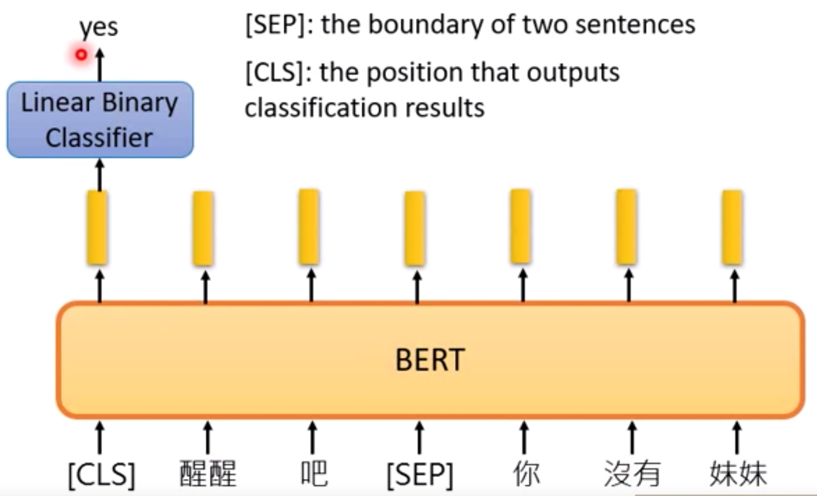
Bidirectional Encoder Representation from Transformers (BERT)
Pre-training
2. Next Sentence Prediction (NSP)
[SEP]: 句子間的分界
[CLS]: 放在句子開頭token, 告訴Encoder要做 Classification
Devlin, Jacob, et al. "Bert: Pre-training of deep bidirectional transformers for language understanding." arXiv preprint arXiv:1810.04805 (2018).

Slide 19
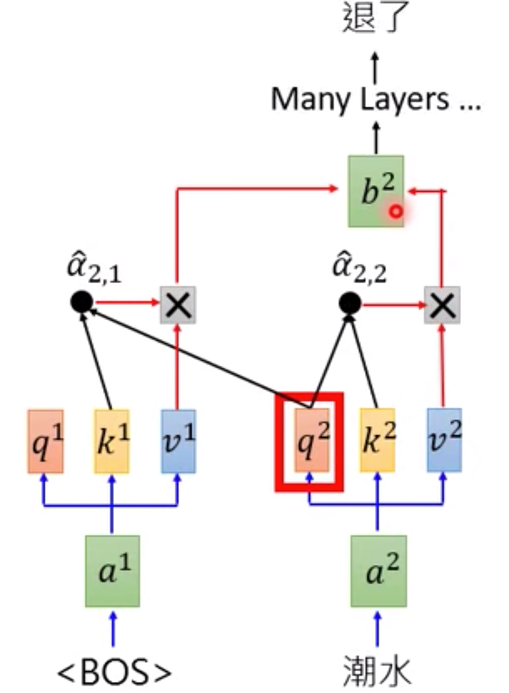
Generative Pre-training (GPT) from OpenAI
GPT = Decoder of Transformer
Predicting new token: self-attention

Slide 20
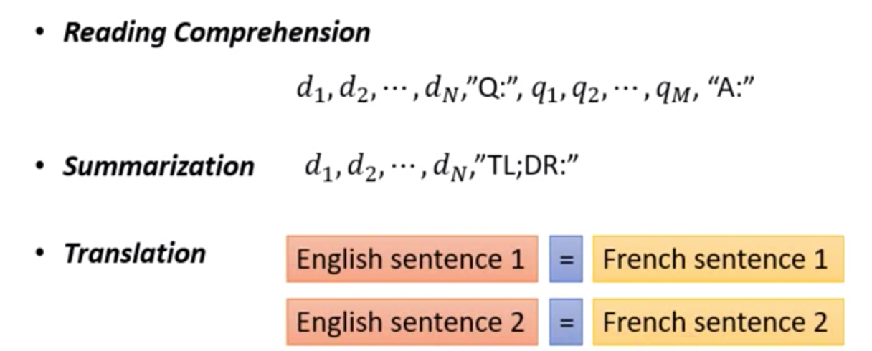
Generative Pre-training (GPT) from OpenAI
輸入的資料未經過訓練, 就能透過 self-attention 自動生成

Slide 21
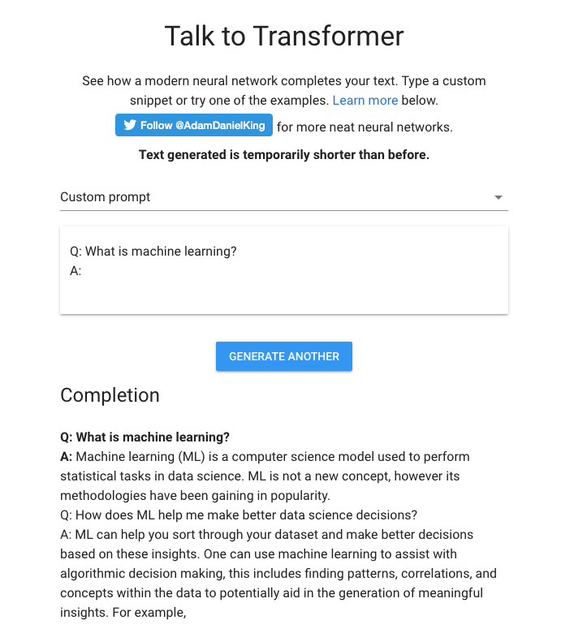
Generative Pre-training (GPT) from OpenAI

Slide 22
Seq2Seq with Attention

Slide 23
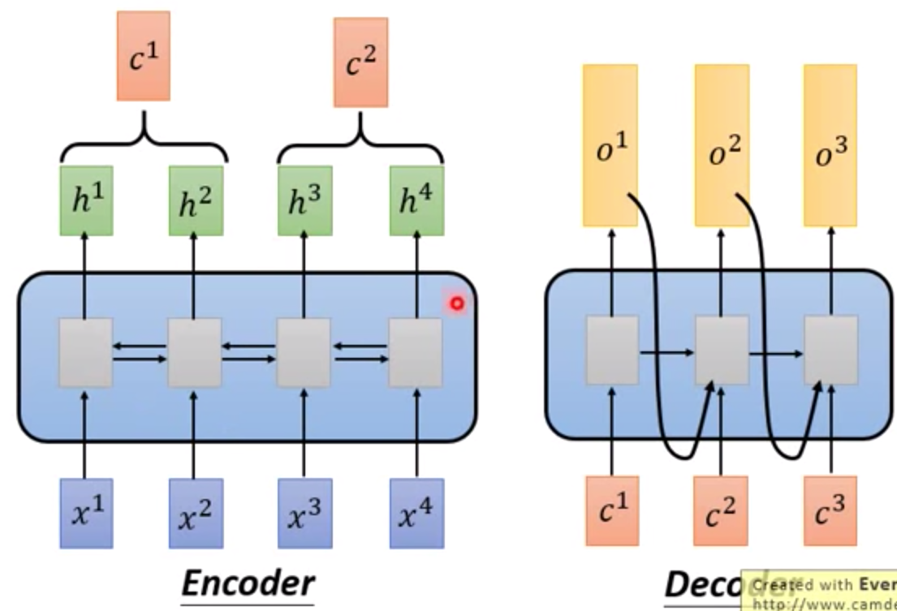
Seq2Seq

Slide 24
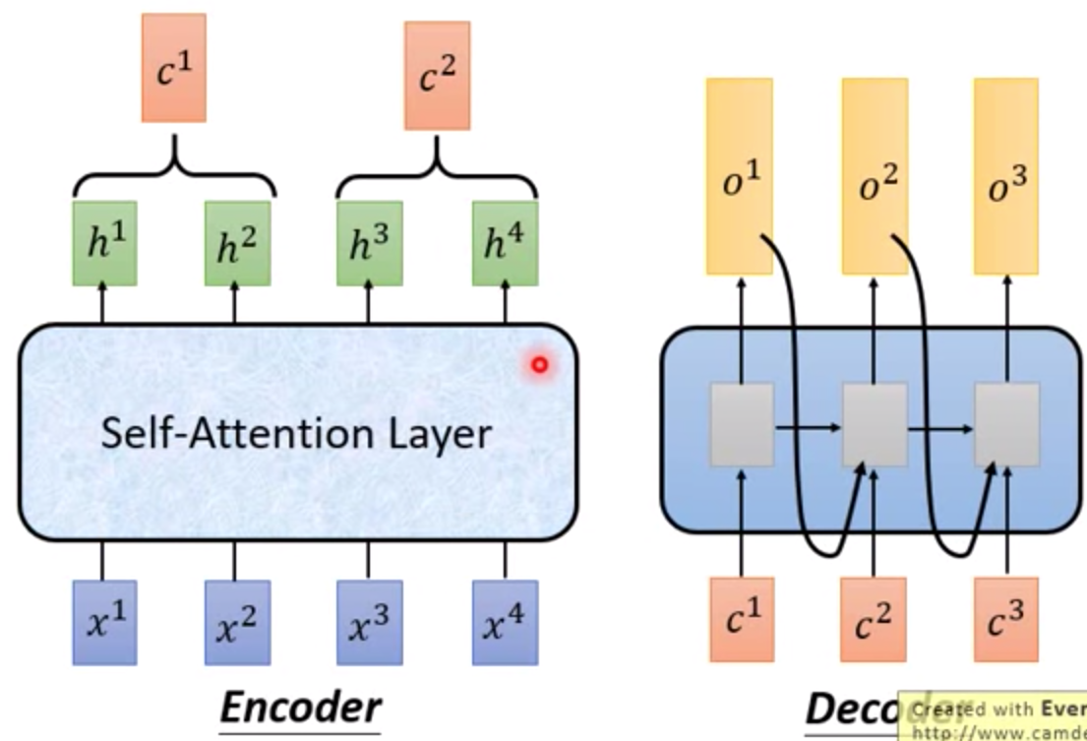
Seq2Seq with Attention

Slide 25
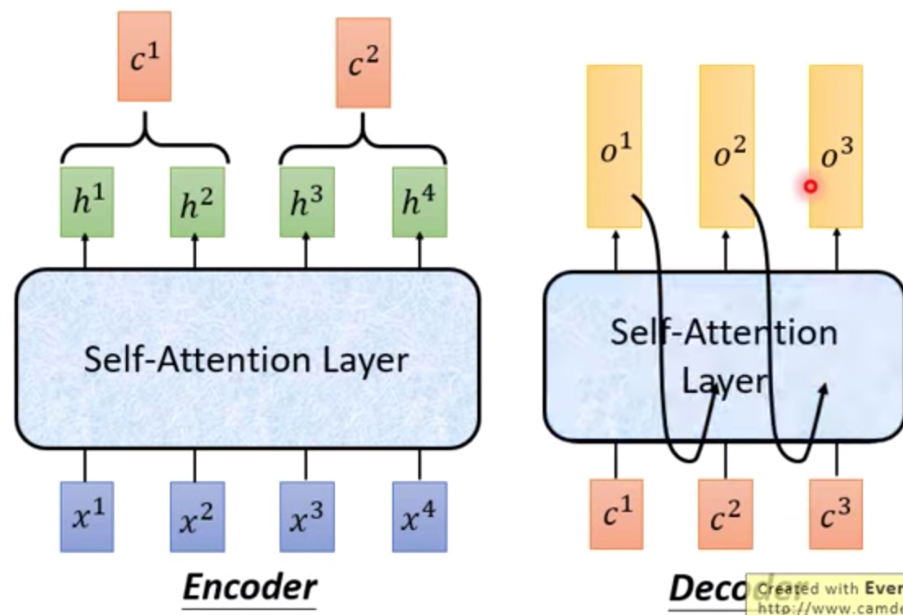
Seq2Seq with Attention

Slide 26

Seq2Seq with Attention
Visualization

Slide 27
Activation Function

Slide 28
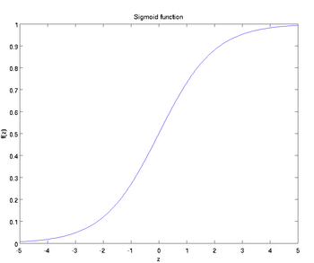
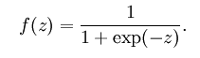
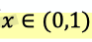
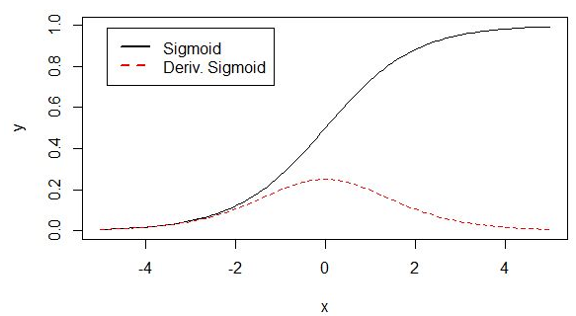
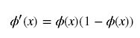
Activation Function
1. Sigmoid

Slide 29
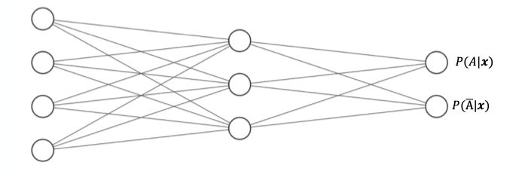
Activation Function
1. Sigmoid

Slide 30
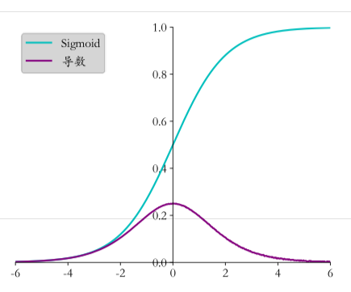
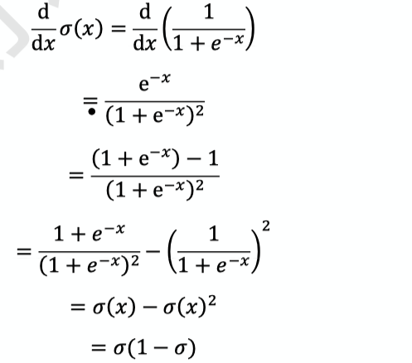
Activation Function
1. Sigmoid
Problem: Gradient Vanishing

Slide 31
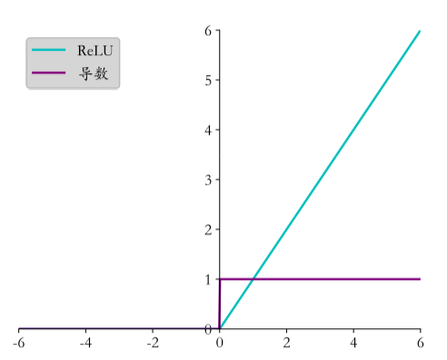
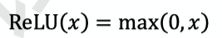
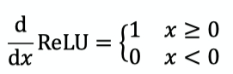
Activation Function
2. ReLU (Rectified Linear Unit)
Compare with Sigmoid
Dead ReLU Problem -> LeakyReLU

Slide 32
Activation Function
2. ReLU (Rectified Linear Unit)
Dead ReLU Problem

Slide 33
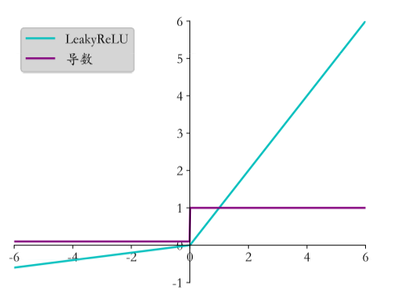
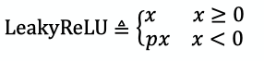
Activation Function
3. LeakyReLU
Compare with ReLU
When p = 0, it becomes ReLU

Slide 34
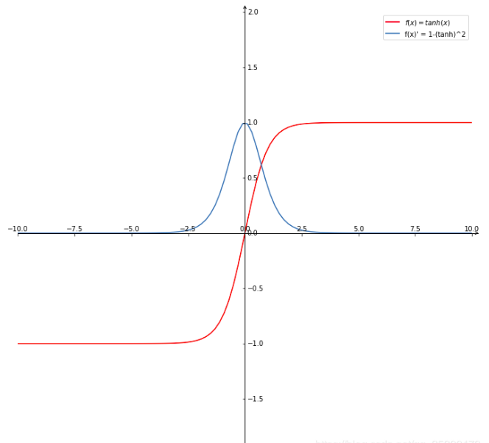
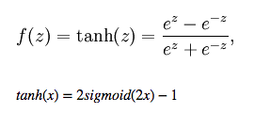
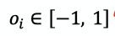
Activation Function
4. Hyperbolic Tangent Function

Slide 35
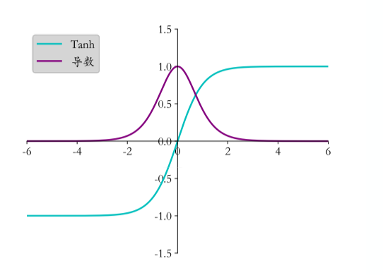
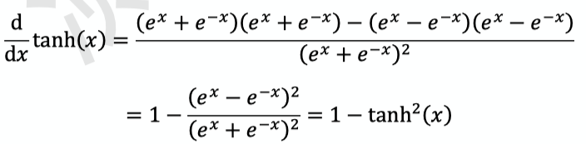
Activation Function
4. Hyperbolic Tangent Function

Slide 36
Activation Function
5. SELU

Slide 37
Activation Function
6. ELU

Slide 38
Activation Function
7. GeLU (Gaussian error Linear Unit)

Slide 39
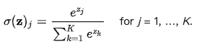
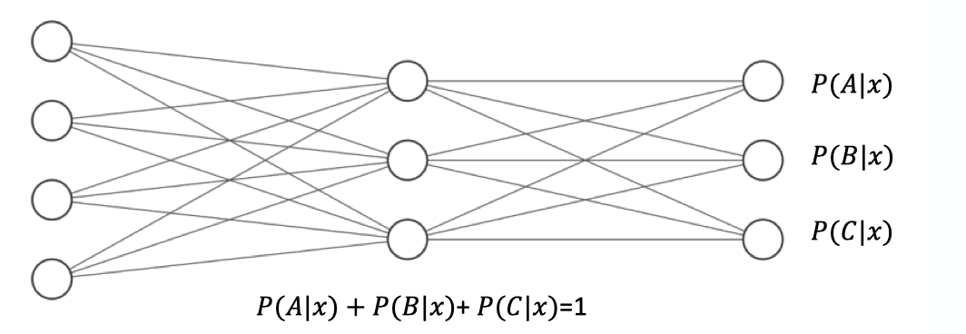
Activation Function
8. Softmax
Softmax(x) = Softmax(x+c)

Slide 40
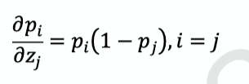
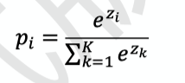
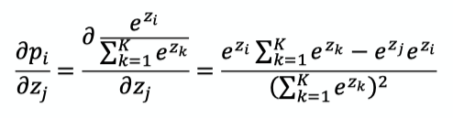
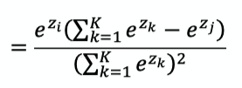
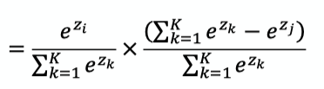
Activation Function
8. Softmax

Slide 41
Math of DL and NN Models

Slide 42
Math of DL and NN Models

Slide 43
Gradient Descent

Slide 44
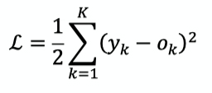
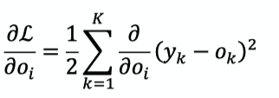
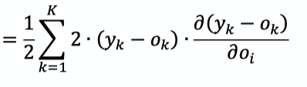



Gradient Descent
Loss Function: Mean Square Error (MSE)

Slide 45
Gradient Descent
Softmax

Slide 46




Gradient Descent
Softmax

Slide 47




Gradient Descent
Cross Entropy
Softmax

Slide 48




Gradient Descent
Softmax
Cross Entropy

Slide 49


Gradient Descent
Cross Entropy
When y is one-hot encoding

Slide 50
Stochastic Gradient Descent

Slide 51
Gradient Exploding
11.6

Slide 52
Gradient Vanishing
11.6

Slide 53
Gradient Clipping
11.6

Slide 54
Learning Rate
Warm up

Slide 55
Overfitting
9.2

Slide 56
Underfitting
9.2

Slide 57
Early Stopping

Slide 58
Backpropagation

Slide 59

Backpropagation
Gradient of single neuron
We use MSE as loss function, and use sigmoid as activation function

Slide 60





Backpropagation
Gradient of single neuron
We use MSE as loss function, and use sigmoid as activation function

Slide 61

Backpropagation
Gradient of Fully-Connected Layer

Slide 62





Backpropagation
Gradient of Fully-Connected Layer

Slide 63



Backpropagation
Gradient of Fully-Connected Layer

Slide 64
Backpropagation
Chain Rule

Slide 65
Cross Entropy
(CE)

Slide 66
Loss Function: Cross Entropy
6.6.2

Slide 67
Gradient Descent
Cross Entropy
Softmax

Slide 68
Gradient Descent
Softmax
Cross Entropy

Slide 69
Gradient Descent
Cross Entropy
When y is one-hot encoding

Slide 70





Cross Entropy
Kullback-Leibler Divergence

Slide 71
Mean Square Error
(MSE)

Slide 72
Weight Decay

Slide 73
Regularization

Slide 74
Regularization

Slide 75
Dropout

Slide 76

Dropout

Slide 77


Dropout

Slide 78
Data Augmentation
In NLP

Slide 79
Data Augmentation

Slide 80
Residual Block

Slide 81
Skip Connection

Slide 82
ResNet

Slide 83


ResBlock

Slide 84
WordPiece

Slide 85
Byte-Pair Encoding (BPE)
Word -> Pieces
"loved","loving","loves"
"lov","ed","ing","es"
Devlin, Jacob, et al. "Bert: Pre-training of deep bidirectional transformers for language understanding." arXiv preprint arXiv:1810.04805 (2018).

Slide 86
Source Code
(Data Preprocessing)

Slide 87
num_train_steps (epochs)
warm_up_steps
https://github.com/the-Quert/iNLPfun/blob/master/BERT/run_classifier.py - L848-L856
MRPC（Microsoft Research Paraphrase Corpus)
Devlin, Jacob, et al. "Bert: Pre-training of deep bidirectional transformers for language understanding." arXiv preprint arXiv:1810.04805 (2018).

Slide 88
file_based_convert_example_to_features
https://github.com/the-Quert/iNLPfun/blob/master/BERT/run_classifier.py - L484-L513
Devlin, Jacob, et al. "Bert: Pre-training of deep bidirectional transformers for language understanding." arXiv preprint arXiv:1810.04805 (2018).

Slide 89
convert_single_example (tokens for different sequence)
https://github.com/the-Quert/iNLPfun/blob/master/BERT/run_classifier.py - L377-L398
Devlin, Jacob, et al. "Bert: Pre-training of deep bidirectional transformers for language understanding." arXiv preprint arXiv:1810.04805 (2018).

Slide 90
tokenize
https://github.com/the-Quert/iNLPfun/blob/master/BERT/tokenization.py - L170-L178
Devlin, Jacob, et al. "Bert: Pre-training of deep bidirectional transformers for language understanding." arXiv preprint arXiv:1810.04805 (2018).

Slide 91
convert_single_example (tokens for different sequence)
https://github.com/the-Quert/iNLPfun/blob/master/BERT/run_classifier.py - L399-L407
Devlin, Jacob, et al. "Bert: Pre-training of deep bidirectional transformers for language understanding." arXiv preprint arXiv:1810.04805 (2018).

Slide 92
﻿_truncate_seq_pair
https://github.com/the-Quert/iNLPfun/blob/master/BERT/run_classifier.py - L564-L578
Devlin, Jacob, et al. "Bert: Pre-training of deep bidirectional transformers for language understanding." arXiv preprint arXiv:1810.04805 (2018).

Slide 93
convert_single_example (tokens for different sequence)
https://github.com/the-Quert/iNLPfun/blob/master/BERT/run_classifier.py - L409-L481
[CLS] Sentence_1 [SEP] Sentence_2 [SEP]
[CLS] Sentence_1 [SEP]
Devlin, Jacob, et al. "Bert: Pre-training of deep bidirectional transformers for language understanding." arXiv preprint arXiv:1810.04805 (2018).

Slide 94
create_model
https://github.com/the-Quert/iNLPfun/blob/master/BERT/run_classifier.py - L581-L590
Devlin, Jacob, et al. "Bert: Pre-training of deep bidirectional transformers for language understanding." arXiv preprint arXiv:1810.04805 (2018).

Slide 95
Source Code
(Modeling)

Slide 96
__init__
https://github.com/the-Quert/iNLPfun/blob/master/BERT/modeling.py - L163-L183
Id-> Word_Embedding
+
Token_type_id
+
Position Encoding
Devlin, Jacob, et al. "Bert: Pre-training of deep bidirectional transformers for language understanding." arXiv preprint arXiv:1810.04805 (2018).

Slide 97



Position Encoding
No position information in self-attention
a打了b = b 打了a
2. Each position has a unique position vector e^{i}
(not learned from data)
3. Each x^{i} appends a one-hot vector p^{i}
Devlin, Jacob, et al. "Bert: Pre-training of deep bidirectional transformers for language understanding." arXiv preprint arXiv:1810.04805 (2018).

Slide 98
Word Embedding
embedding_lookup
https://github.com/the-Quert/iNLPfun/blob/master/BERT/modeling.py/ - L404-L435
Devlin, Jacob, et al. "Bert: Pre-training of deep bidirectional transformers for language understanding." arXiv preprint arXiv:1810.04805 (2018).

Slide 99
token_type Embedding
embedding_post_postprocessor
https://github.com/the-Quert/iNLPfun/blob/master/BERT/modeling.py/ - L480-L500
Devlin, Jacob, et al. "Bert: Pre-training of deep bidirectional transformers for language understanding." arXiv preprint arXiv:1810.04805 (2018).

Slide 100
Position Embedding
embedding_post_postprocessor
https://github.com/the-Quert/iNLPfun/blob/master/BERT/modeling.py/ - L502-L535
Devlin, Jacob, et al. "Bert: Pre-training of deep bidirectional transformers for language understanding." arXiv preprint arXiv:1810.04805 (2018).

Slide 101

Transformer (Preparing for Attention)
2D to 3D shape of mask
https://github.com/the-Quert/iNLPfun/blob/master/BERT/modeling.py/ - L199-L222
Devlin, Jacob, et al. "Bert: Pre-training of deep bidirectional transformers for language understanding." arXiv preprint arXiv:1810.04805 (2018).

Slide 102

transformer_model
Residual Connection
https://github.com/the-Quert/iNLPfun/blob/master/BERT/modeling.py/ - L823-L848
Devlin, Jacob, et al. "Bert: Pre-training of deep bidirectional transformers for language understanding." arXiv preprint arXiv:1810.04805 (2018).

Slide 103

Build Q, K, V Matrix (Self-Attention)
transformer_model
https://github.com/the-Quert/iNLPfun/blob/master/BERT/modeling.py/ - L850-L872
attention_layer:
transpose_for_scores
Devlin, Jacob, et al. "Bert: Pre-training of deep bidirectional transformers for language understanding." arXiv preprint arXiv:1810.04805 (2018).

Slide 104

Scaled Dot-Product Attention
transformer_model
attention_layer:
transpose_for_scores
https://github.com/the-Quert/iNLPfun/blob/master/BERT/modeling.py/ - L646-L723\
Devlin, Jacob, et al. "Bert: Pre-training of deep bidirectional transformers for language understanding." arXiv preprint arXiv:1810.04805 (2018).

Slide 105
Preparing for softmax
transpose_for_scores
https://github.com/the-Quert/iNLPfun/blob/master/BERT/modeling.py/ - L726-L776
Devlin, Jacob, et al. "Bert: Pre-training of deep bidirectional transformers for language understanding." arXiv preprint arXiv:1810.04805 (2018).

Slide 106
Fully Connected Layer
(including Residual Connection)
https://github.com/the-Quert/iNLPfun/blob/master/BERT/run_classifier.py/ - L450
Devlin, Jacob, et al. "Bert: Pre-training of deep bidirectional transformers for language understanding." arXiv preprint arXiv:1810.04805 (2018).

Slide 107
Batch Normalization

Slide 108

Hidden Layer

Slide 109

Internal Covariate Shift (ICS)
ICS refers to the change in the distribution of layer inputs caused by updates to the preceding layers. It is conjectured that such continual change negatively impacts training. The goal of BatchNorm was to reduce ICS and thus remedy this effect.

Slide 110

Batch Normalization

Slide 111

Batch Normalization
Saturation Region

Slide 112

Batch Normalization

Slide 113

Batch Normalization
Benefit

Slide 114
Batch Normalization (Abstract)
Batch Normalization (BatchNorm) is a widely adopted technique that enables faster and more stable training of deep neural networks (DNNs).
Despite its pervasiveness, the exact reasons for BatchNorm’s effectiveness are still poorly understood. The popular belief is that this effectiveness stems from controlling the change of the layers’ input distributions during training to reduce the so-called “internal covariate shift”.

Slide 115
Batch Normalization (Abstract)
In this work, we demonstrate that such distributional stability of layer inputs has little to do with the success of BatchNorm.
Instead, we uncover a more fundamental impact of BatchNorm on the training process: it makes the optimization landscape significantly smoother. This smoothness induces a more predictive and stable behavior of the gradients, allowing for faster training.

Slide 116


Batch Normalization + Covariate Shift ?

Slide 117

Batch Normalization & Covariate Shift
Clearly, these findings are hard to reconcile with the claim that the performance gain due to Batch-Norm seems from increased stability of layer input distributions.

Slide 118

Batch Normalization works
Deep Linear Networks

Slide 119

Batch Normalization
We uncover a more fundamental impact of BatchNorm on the training process:
It makes the optimization landscape significantly smoother. This smoothness induces a more predictive and stable behavior of the gradients, allowing for faster training.

Slide 120
Batch Normalization
Indeed, we identify the key impact that BatchNorm has on the training process: it reparametrizes the underlying optimization problem to make its landscape significantly more smooth.
The first manifestation of this impact is improvement in the Lipschitzness of the loss function.

Slide 121
Batch Normalization
That is, the loss changes at a smaller rate and the magnitudes of the gradients are smaller too. There is, however, an even stronger effect at play. Namely, BatchNorm’s reparametrization makes gradients of the loss more Lipschitz too.

Slide 122
Batch Normalization
To understand why, recall that in a vanilla (non-BatchNorm), deep neural network, the loss function is not only non-convex but also tends to have a large number of “kinks”, flat regions, and sharp minima.
This makes gradient descent–based training algorithms unstable,
e.g., due to exploding or vanishing gradients, and thus highly sensitive to the choice of the learning rate and initialization.

Slide 123
input_mask
https://github.com/the-Quert/iNLPfun/blob/master/BERT/run_classifier.py/ - L446-L454

Slide 124
Word2Vec
the-Quert

Slide 125


One-hot encoding and WordNet
Problem with words as discrete symbols
WordNet – synonyms, hypernyms, hyponyms
Word meanings, relationships between words
^{Problems with WordNet}
the-Quert, CS224N

Slide 126

Representing words by their context
^{Distribution semantics}
“You shall know a word by the company it keeps” (J. R. Firth 1957: 11)
the-Quert, CS224N

Slide 127


Word meaning as a neural word vector - visualization
Word vectors (word embedding, word representation)
^{Distributed representation}
^{Two-dimensional view}
the-Quert, CS224N

Slide 128


Traditional Word Vector
^{Cosine Similarity}
^{Distance and angle}
the-Quert

Slide 129




Word Embedding
Count based
Prediction based
Word2vec
W_{i-1} ~ W_{i-N}
the-Quert, Hung-yi Lee

Slide 130


Word Embedding - Prediction based
Make W_{i} equal to W_{j}, given W_{i} and W_{j} the same initialization
the-Quert, Hung-yi Lee

Slide 131


Word2vec
Continuous Bag of Words (CBOW)
Skip-gram (SG)
the-Quert, Hung-yi Lee

Slide 132

Word2vec
Word2vec (Mikolov et al. 2013) is a framework for learning word vectors.
the-Quert, CS224N

Slide 133


Word2vec
the-Quert, CS224N

Slide 134


Word2vec objective function
^{Objective function}
the-Quert, CS224N

Slide 135


Word2vec objective function
^{Objective function}
Calculate each word with two vectors
the-Quert, CS224N

Slide 136


To train the model: Compute all vector gradients
the-Quert, CS224N

Slide 137

Model Details
the-Quert, CS224N

Slide 138

Model Details
Reverse SG -> CBOW
the-Quert

Slide 139
Word2vec
Continuous Bag of Words (CBOW)
Skip-gram (SG)
the-Quert, Hung-yi Lee

Slide 140
Training Model
^{Negative Sampling}
^{Sub-sampling}
the-Quert

Slide 141
Model Details (Negative Sampling)
Word pairs -> Words
Phrase detection is covered in the “Learning Phrases” section of their paper.
They shared their implementation in word2phrase.–I’ve shared a commented
(but otherwise unaltered) copy of this code here.
the-Quert, CS224N

Slide 142
Model Details (Negative Sampling)
Each pass of their tool only looks at combinations of 2 words, but you can run it multiple times to get longer phrases.
So, the first pass will pick up the phrase “New_York”, and then running it again will pick up “New_York_City” as a combination of “New_York” and “City”.
the-Quert, CS224N

Slide 143
Model Details (Sub-Sampling)
the-Quert, CS224N

Slide 144
Model Details (Sub-Sampling)
For each word we encounter in our training text, there is a chance that we will effectively delete it from the text. The probability that we cut the word is related to the word’s frequency.
If we have a window size of 10, and we remove a specific instance of “the” from our text:
As we train on the remaining words, “the” will not appear in any of their context windows.
We’ll have 10 fewer training samples where “the” is the input word.
the-Quert, CS224N

Slide 145


Model Details (Sub-Sampling)
Sampling Rate
the-Quert, CS224N

Slide 146
Model Details (Negative Sampling)
Negative sampling addresses this by having each training sample only modify a small percentage of the weights, rather than all of them. Here’s how it works.
When training the network on the word pair (“fox”, “quick”), recall that the “label” or “correct output” of the network is a one-hot vector.
That is, for the output neuron corresponding to “quick” to output a 1, and for all of the other thousands of output neurons to output a 0.
the-Quert

Slide 147


Model Details (Negative Sampling)
The authors state in their paper that they tried a number of variations on this equation, and the one which performed best was to raise the word counts to the 3/4 power:
the-Quert, CS224N

Slide 148
Model Details (Negative Sampling)
With negative sampling, we are instead going to randomly select just a small number of “negative” words (let’s say 5) to update the weights for. (In this context, a “negative” word is one for which we want the network to output a 0 for). We will also still update the weights for our “positive” word (which is the word “quick” in our current example).
Recall that the output layer of our model has a weight matrix that’s
300 x 10,000. That’s a total of 6 output neurons, and 1,800 weight values total. That’s only 0.06% of the 3M weights in the output layer.
the-Quert

Slide 149
Detailed Conceptions
Of
Word2Vec and GloVe
the-Quert

Slide 150
Main idea of Word2Vec
Synonym
Hypernym
Problems
In the context
Update corpus
Similarity is subjective
the-Quert

Slide 151
Word2Vec: Problems with One-hot vectors (detailed)
Vectors are orthogonal: Problems with similarity.
Sparse matrix
# We want dense matrix, not the sparse ones
Observation from linguists
# Notation of contexts
We need Word2Vec
the-Quert

Slide 152
Find the Word Vectors – Prediction based
Model based on “Locale context window”
# Lexicon Size: Input , Output
Disadvantages:
# Problems with probabilities
the-Quert, Hung-yi Lee

Slide 153
Optimization and Problems
Gradient Descent
Stochastic Gradient Descent
Mini-batch
# Minimize the noise from gradient estimation
# Parallel computing on GPU
the-Quert

Slide 154
Optimization: GD, SGD, Mini-batch
Stochastic gradients with word vectors
# Problems with sparse matrix
# Solution:
Update specific row in matrix ”U” and “V”
the-Quert

Slide 155
Word2Vec: More details
Why two vectors for each word ?
# More easier to do optimization
Variants of model:
# Skip-grams (SG)
# Continuous Bags of Words (CBOW)
the-Quert

Slide 156
The SG Model with Negative Sampling
Solution with frequent words
SGD:
# See all ”Vc” before calculating all gradients
# It can only update the word appear in current window
the-Quert

Slide 157

Negative Sampling
Minimizing the value from dot-product
Binary Logistic Regression: Training with true-pair and noise-pair
Objective Function:
Maximum Likelihood
the-Quert

Slide 158



Problems with Co-occurrence counts
Co-occurrence matrix: Window and Word-Document
Word-Document:
the-Quert, CS224N

Slide 159

Problems with Co-occurrence counts
the-Quert, CS224N

Slide 160

Dimensionality Reduction with SVD
the-Quert, CS224N

Slide 161

Dimensionality Reduction with SVD:
Hacks to X (several used in Rohde et al., 2015)
the-Quert, CS224N

Slide 162

Dimensionality Reduction with SVD:
Hacks to X (several used in Rohde et al., 2015)
the-Quert, CS224N

Slide 163

Counting based vs. Direct prediction
the-Quert, CS224N

Slide 164
GloVe: Global Vectors for
Word Representation
the-Quert

Slide 165
GloVe: Training - Review
Comparison with Previous Models: LSA, HAL
Counted Based
Singular Value Decomposition (SVD)
the-Quert, CS224N
1 Course Instructors: Christopher Manning, Richard Socher
2 Authors: Rohit Mundra, Emma Peng, Richard Socher, Ajay Sohmshetty, Amita Kamath

Slide 166
GloVe: Training – Previous Models
Comparison with Previous Models: NN Model with 1 hidden layer
Continuous Bag of Words (CBOW)
Skip-gram (SG)
the-Quert, CS224N
1 Course Instructors: Christopher Manning, Richard Socher
2 Authors: Rohit Mundra, Emma Peng, Richard Socher, Ajay Sohmshetty, Amita Kamath

Slide 167
GloVe: Training - Optimization
Word vectors in high-dimensional spaces
Most of the properties of high-dimensional vectors spaces are intuitive, cause in a high-dimensional vector space, a word can be closed to lots of other words in different directions.
Learning word vectors --> Optimization
the-Quert, CS224N
1 Course Instructors: Christopher Manning, Richard Socher
2 Authors: Rohit Mundra, Emma Peng, Richard Socher, Ajay Sohmshetty, Amita Kamath

Slide 168
GloVe: Training - SGD
Optimization
Stochastic Gradient Descent
Advantages of mini-batch
Minimize the noise during GD stage
Parallel computing on GPU
the-Quert, CS224N
1 Course Instructors: Christopher Manning, Richard Socher
2 Authors: Rohit Mundra, Emma Peng, Richard Socher, Ajay Sohmshetty, Amita Kamath

Slide 169


GloVe: Training - SGD
Stochastic Gradient Descent with Word Vectors
would be sparse, we only update the vectors actually existed before.
Softmax is expensive
the-Quert, CS224N
1 Course Instructors: Christopher Manning, Richard Socher
2 Authors: Rohit Mundra, Emma Peng, Richard Socher, Ajay Sohmshetty, Amita Kamath

Slide 170
GloVe: Training – Negative Sampling
Softmax is expensive
Skip-gram with Negative Sampling
the-Quert, CS224N
1 Course Instructors: Christopher Manning, Richard Socher
2 Authors: Rohit Mundra, Emma Peng, Richard Socher, Ajay Sohmshetty, Amita Kamath

Slide 171


GloVe: Training – Negative Sampling
Loss Function - Original
Loss Function with Negative Sample
the-Quert, CS224N
1 Course Instructors: Christopher Manning, Richard Socher
2 Authors: Rohit Mundra, Emma Peng, Richard Socher, Ajay Sohmshetty, Amita Kamath

Slide 172

Unigram Distribution
Used as the distribution for sampling
the-Quert

Slide 173

GloVe: Training – Problems with Co-occurrence counts
Co-occurrence Matrix
Windows: Word2Vec
Word-Document: Word-Document related
Word-Document (Ex: LSA)
:
the-Quert, CS224N
1 Course Instructors: Christopher Manning, Richard Socher
2 Authors: Rohit Mundra, Emma Peng, Richard Socher, Ajay Sohmshetty, Amita Kamath

Slide 174
GloVe: Training – Problems with Co-occurrence counts
Word-Document (Ex: LSA)
:
Ex:
I like deep learning
I like NLP
I enjoy flying
the-Quert, CS224N
1 Course Instructors: Christopher Manning, Richard Socher
2 Authors: Rohit Mundra, Emma Peng, Richard Socher, Ajay Sohmshetty, Amita Kamath

Slide 175

GloVe: Training – Problems with Co-occurrence counts
the-Quert, CS224N
1 Course Instructors: Christopher Manning, Richard Socher
2 Authors: Rohit Mundra, Emma Peng, Richard Socher, Ajay Sohmshetty, Amita Kamath

Slide 176


GloVe: Training – Dimensionality Reduction on X
Singular Value Decomposition (SVD)
:
:
U and V are orthonormal
the-Quert, CS224N
1 Course Instructors: Christopher Manning, Richard Socher
2 Authors: Rohit Mundra, Emma Peng, Richard Socher, Ajay Sohmshetty, Amita Kamath

Slide 177
GloVe: Training – Dimensionality Reduction on X
Hacks to X (used in Rhode et al., 2005)
:
:
Scaling the counts
min(X,t), with t ≈ 100
Use Pearson correlations instead of counts, then set negative values to 0
the-Quert, CS224N
1 Course Instructors: Christopher Manning, Richard Socher
2 Authors: Rohit Mundra, Emma Peng, Richard Socher, Ajay Sohmshetty, Amita Kamath

Slide 178


GloVe: Training – Dimensionality Reduction on X
the-Quert, CS224N
1 Course Instructors: Christopher Manning, Richard Socher
2 Authors: Rohit Mundra, Emma Peng, Richard Socher, Ajay Sohmshetty, Amita Kamath

Slide 179
GloVe: Training – Core Techniques
Counted based model --> Co-occurrence Matrix
Only performs well on high-probability words and worse on word analogy tasks
Combine count based SVD model and direct prediction model
the-Quert, CS224N
1 Course Instructors: Christopher Manning, Richard Socher
2 Authors: Rohit Mundra, Emma Peng, Richard Socher, Ajay Sohmshetty, Amita Kamath

Slide 180

Processing with Word Sense: Encoding meaning in vector differences
Crucial Insight: Ratio of co-occurrence probabilities can encode meaning components
the-Quert, CS224N
1 Course Instructors: Christopher Manning, Richard Socher
2 Authors: Rohit Mundra, Emma Peng, Richard Socher, Ajay Sohmshetty, Amita Kamath

Slide 181

Processing with Word Sense: Encoding meaning in vector differences
Crucial Insight: Ratio of co-occurrence probabilities can encode meaning components
the-Quert, CS224N
1 Course Instructors: Christopher Manning, Richard Socher
2 Authors: Rohit Mundra, Emma Peng, Richard Socher, Ajay Sohmshetty, Amita Kamath

Slide 182




Processing with Word Sense: Encoding meaning in vector differences
Log-bilinear model:
Log-bilinear model with Vector differences:
the-Quert

Slide 183







GloVe: Model Explained
Symmetry Analysis
the-Quert

Slide 184


GloVe: Model Explained
Weighted Least Squares Regression (goto p.207)
A better weighted function
the-Quert

Slide 185


Unigram and Bigram Distribution
Unigram Distribution
Given meaningful sentences, to build a word-distribution LM model
Sequence Input: P(W₁, W₂, W₃, …W_{n})
Bigram Distribution
the-Quert

Slide 186
Evaluation of Word Vectors
Intrinsic Evaluation
Evaluate word vectors with word similarity and word analogy
Fast, help to understand the system
Not sure if really helpful unless correlation to real tasks is established
the-Quert

Slide 187

Evaluation of Word Vectors
Intrinsic Evaluation
Input
Word Embedding
Input word vectors to ML system
Mapping the output word vectors to real words
Output words
the-Quert

Slide 188




Intrinsic Evaluation Examples: Word Vectors Analogies
-->
the-Quert

Slide 189

Details of intrinsic word vector evaluation
the-Quert

Slide 190

Details of intrinsic word vector evaluation
the-Quert

Slide 191

Analogy evaluation and hyperparameters
the-Quert

Slide 192


Analogy evaluation and hyperparameters
the-Quert

Slide 193

Analogy evaluation and hyperparameters
the-Quert

Slide 194

Intrinsic Evaluation: Consine Similarity
the-Quert

Slide 195

Intrinsic Evaluation: Correlation Evaluation
the-Quert

Slide 196
Word Senses and word sense ambiguity
Most words have lots of meanings
Common words
Words that have existed for a long time
the-Quert

Slide 197
Dealing With Ambiguity
Solutions
Collect the senses of words that exist before
Each word is represented with weight mean of its contexts
Use ”spherical kmeans” to cluster contexts
Training clusters
the-Quert

Slide 198

Dealing With Ambiguity
the-Quert

Slide 199
Evaluation of Word Vectors
Extrinsic Evaluation
Slow and complex
Use with QA system
Error occurrs
the-Quert

Slide 200


Training for Extrinsic Tasks
Problem Formulation
the-Quert

Slide 201

Training for Extrinsic Tasks
Retraining Word Vectors
If the training dataset is small, it’s not proper to retrain word vectors.
the-Quert

Slide 202




Training for Extrinsic Tasks
Softmax Classification and Regularization
Loss Function
the-Quert

Slide 203


Training for Extrinsic Tasks
Softmax Classification and Regularization
We need to update parameters
To prevent overfitting:
Amount:
Reduce the network size
Cross Validation
Add weight regularization
Remove irrelevant features
Add Dropout
Data Augmentation
the-Quert

Slide 204

Training for Extrinsic Tasks
Softmax Classification and Regularization
To prevent overfitting: Bayes, and add Apriori Distribution
the-Quert

Slide 205


Training for Extrinsic Tasks
Window Classification
the-Quert

Slide 206


Training for Extrinsic Tasks
Non-linear Classifiers
the-Quert

Slide 207


Least Squares Objective
Calculating the probability with Softmax (from Skip-gram)
Cross Entropy
the-Quert

Slide 208



Least Squares Objective
Combining the same value between i and j:
To minimum the normalization factor:
Non-normalized distribution:
the-Quert

Slide 209


Least Squares Objective
Minimize the mean square error:
Generalize the model:
the-Quert

Slide 210
Demo: Word2Vec
the-Quert

Slide 211
Word2vec (Implementation)
^{Wiki data preprocessing}
https://colab.research.google.com/github/the-Quert/inlpfun/blob/master/word2vec/word2vec.ipynb
https://github.com/the-Quert/inlpfun/blob/master/word2vec/wiki_to_txt.py
the-Quert

Slide 212
Word2vec (Implementation)
Segmentation (Stopwords, CN2TW)
https://github.com/the-Quert/inlpfun/blob/master/word2vec/segmentaion.py
the-Quert

Slide 213
Word2vec (Implementation)
^{View Chinese Stopwords}
https://github.com/the-Quert/inlpfun/blob/master/word2vec/stopwords.txt
the-Quert

Slide 214
Word2vec (Implementation)
^{Training and task processing}
https://github.com/the-Quert/inlpfun/blob/master/word2vec/train.py
https://github.com/the-Quert/inlpfun/blob/master/word2vec/main.py
the-Quert

Slide 215
Demo: GloVe
the-Quert

Slide 216
Transformer

Slide 217


RNN
CNN

Slide 218





Self-attention
Word-Embedding
Attention

Slide 219


Self-attention

Slide 220

Self-attention

Slide 221

Self-attention

Slide 222



Self attention with Parallels Computing

Slide 223

Self-attention and Padding Mask

Slide 224
Position Encoding
No position information in self-attention
a打了b = b 打了a
2. Each position has a unique position vector e^{i}
(not learned from data)
3. Each x^{i} appends a one-hot vector p^{i}

Slide 225

Multi-head Attention

Slide 226
Architecture of Transformer

Slide 227


Self-Attention Visualization

Slide 228
Self-Attention Visualization

Slide 229

Multi-Head Attention Visualization

Slide 230
Recurrent Neural Network
(RNN)

Slide 231

Simple RNN Model

Slide 232


Simple RNN Model

Slide 233


Simple-RNN Model

Slide 234


Simple-RNN Model

Slide 235



Simple-RNN Model

Slide 236

Simple-RNN Model Categories

Slide 237

Bidirectional Simple-RNN
Example: Bidirectional LSTM -> Seq2Seq

Slide 238
Gradient Vanishing and Gradient Explosion in RNN

Slide 239
Gradient Clipping in RNN

Slide 240


The problem of long-term dependencies

Slide 241
Long Short-term Memory
(LSTM)

Slide 242

LSTM Model
The vanishing gradient problem of RNN is resolved.

Slide 243


RNN cells and LSTM cells

Slide 244




LSTM Model
Input
Forget
Output

Slide 245

LSTM - Example

Slide 246

LSTM - Example

Slide 247

LSTM - Example
Input vectors between RNN and LSTM

Slide 248

LSTM

Slide 249

LSTM

Slide 250

Multi-Layer LSTM

Slide 251

BERT and RNN (LSTM)
BERT
Transformer which removes the LSTM, and only uses attention to transmit information across time.

Slide 252
BERT and LSTM
LSTM
One weakness of the LSTM, and of many contemporary RNNs,
is capacity.

Slide 253
Gated Recurrent Unit
(GRU)

Slide 254
LSTM Model
Input Gate
Forget Gate
Output Gate

Slide 255



GRU Model
Reset Gate
Update Gate

Slide 256

GRU Model
Reset Gate

Slide 257



GRU Model
Update Gate

Slide 258
Demo: Sentiment Analysis
using BERT

Slide 259

Bidirectional Encoder Representation from Transformers (BERT)
Sentiment Analysis
Devlin, Jacob, et al. "Bert: Pre-training of deep bidirectional transformers for language understanding." arXiv preprint arXiv:1810.04805 (2018).

Slide 260
Bidirectional Encoder Representation from Transformers (BERT)
Pre-training
Masked Language Model (MLM)
Devlin, Jacob, et al. "Bert: Pre-training of deep bidirectional transformers for language understanding." arXiv preprint arXiv:1810.04805 (2018).

Slide 261
Bidirectional Encoder Representation from Transformers (BERT)
Pre-training
2. Next Sentence Prediction (NSP)
[SEP]: 句子間的分界
[CLS]: 放在句子開頭token, 告訴Encoder要做 Classification
Devlin, Jacob, et al. "Bert: Pre-training of deep bidirectional transformers for language understanding." arXiv preprint arXiv:1810.04805 (2018).

Slide 262
Demo: Sentiment Analysis on IMDb using BERT
➔ A new method of unsupervised pre-training language representations,
which extracts features from raw text input.
➔ A classifier can then be stacked on top of the representation and perform
supervised fine-tuning on our sentiment task. (Transfer Learning)
Devlin, Jacob, et al. "Bert: Pre-training of deep bidirectional transformers for language understanding." arXiv preprint arXiv:1810.04805 (2018).

Slide 263
Demo: Sentiment Analysis on IMDb using BERT
Large Movie Review Dataset (IMDb) from Stanford
50,000 highly polar, preprocessed movie reviews (as of 2011)
https://colab.research.google.com/github/the-Quert/inlpfun/blob/master/Lab/Demo/BERT/bert_demo.ipynb
Devlin, Jacob, et al. "Bert: Pre-training of deep bidirectional transformers for language understanding." arXiv preprint arXiv:1810.04805 (2018).

Slide 264
Demo: Sentiment Analysis
using LSTM and GRU

Slide 265


Demo: Sentiment Analysis using LSTM
RNN
The hidden state vector at the final time step is fed into a binary softmax classifier where it is multiplied by another weight matrix and put through a softmax function that outputs values between 0 and 1.

Slide 266
Demo: Sentiment Analysis using LSTM
LSTM
(with 4 fully connected layers )
Input (with 2 FC)
Forget (with 1 FC)
Output (with 1 FC)

Slide 267
Demo: Sentiment Analysis using LSTM
Word Embedding: Word2Vec and GloVe
The GloVe matrix will contain 400,000 word vectors, each with a dimensionality of 50.

Slide 268

Demo: Sentiment Analysis using LSTM
Index and Embedding Matrix
Output: 10 X 50

Slide 269
Demo: Sentiment Analysis using LSTM
Dataset: Large Movie Review Dataset (IMDb) from Stanford
50,000 highly polar, preprocessed movie reviews (as of 2011)
https://colab.research.google.com/github/the-Quert/inlpfun/blob/master/Lab/Demo/LSTM/lstm_demo.ipynb

Slide 270
Demo: Sentiment Analysis using LSTM
Dataset: Large Movie Review Dataset (IMDb) from Stanford
50,000 highly polar, preprocessed movie reviews (as of 2011)
Accuracy
BERT: 85.82866
LSTM: 50.89166

Slide 271
Demo: Sentiment Analysis using LSTM and GRU
Dataset: First GOP Debate Twitter Sentiment
Analyze tweets on the first 2016 GOP Presidential Debate
https://colab.research.google.com/github/the-Quert/inlpfun/blob/master/Demo/LSTM/lstmGRU_GOP.ipynb

Slide 272
Demo: Sentiment Analysis using LSTM and GRU
Dataset: First GOP Debate Twitter Sentiment
Analyze tweets on the first 2016 GOP Presidential Debate
Accuracy for Negative Comments
LSTM: 93.543046
GRU: 99.172185

Slide 273
Source Code Analysis:
Transformer

Slide 274
Source Code
Word-Embedding
Attention

Slide 275

Source Code

Slide 276
Source Code
https://github.com/theQuert/inlpfun/blob/master/custom/encoder_decoder_transformer.py

Slide 277
Research Project:
Transformer, SHA-RNN

Slide 278
Recurrent Neural Network

Slide 279
Recurrent Neural Network

Slide 280
Long Short-term Memory (LSTM)

Slide 281
Long Short-term Memory (LSTM)
One weakness of the LSTM, and of many contemporary RNNs,
is capacity.

Slide 282
Problems of RNN and LSTM
Sequential computation inhibits parallelization
No explicit modeling of long and short range dependencies
“Distance” between positions is linear

Slide 283
Transformer
Self-Attention

Slide 284
Transformer
Multi-Head Attention

Slide 285
Transformer
Self-Attention
Attention is a technique that is used in a neural network.
For RNNs, instead of only encoding the whole sentence in a hidden state, each word has a corresponding hidden state that is passed all the way to the decoding stage.
Then, the hidden states are used at each step of the RNN to decode.

Slide 286
Transformer Decoding with One Write-Head
Neural Attention
Neural Attention, introduced by [Bahdanau et al., 2014], is a powerful tool for manipulating variable-length representations.
A neural attention function takes a single query-vector q and a set of m different (key-vector, value-vector) pairs (represented by the matrices K and V ), and produces an output vector y.
The output y is computed as a weighted sum of the different value vectors, where the weights are derived by comparing the query to the keys.

Slide 287
Transformer Decoding with One Write-Head
Problem with Transformer
In some settings, data dependencies make it is impossible to process queries from multiple positions in parallel.
An example is a self-attention layer in an autoregressive language model such as Transformer [Vaswani et al., 2017].
The queries produced at each position attend to key-value pairs produced at all positions up to and including that position.

Slide 288
Transformer Decoding with One Write-Head
Batched Multi-head Attention
We introduce multi-query Attention as a variation of multi-head attention as described in [Vaswani et al., 2017].
Multi-head attention consists of multiple attention layers (heads) in parallel with different linear transformations on the queries, keys, values and outputs.
Multi-query attention is identical except that the different heads share a single set of keys and values.

Slide 289

Single Headed Attention RNN (SHA-RNN)
Pointer based attention
First, does anyone have any freaking clue how many attention heads we need (Shazeer, 2019)?
Second, why are we putting so much work into the attention layer? Are we sure about the benefit that this swarm of attention heads, each involving substantial compute, bring?
Linear network is used to convert memory tensor from encoder to K, V

Slide 290

Single Headed Attention RNN (SHA-RNN)
Boom Layer
Activation Function: GeLU

Slide 291

New Model

Slide 292
RoBERTa:
A Robustly Optimized BERT Pretraing Approach

Slide 293

Comparison with BERT
Dynamic Masking

Slide 294

Comparison with BERT
More Data for Pre-training

Slide 295

Comparison with BERT
Large Batch

Slide 296
Comparison with BERT
Next Sentence Prediction
We next compare training without the NSP loss and training with blocks of text from a single document (DOC-SENTENCES).
We find that this setting outperforms the originally published BERT_{BASE} results and that removing the NSP loss matches or slightly improves downstream task performance, in contrast to Devlin et al. (2019).
It is possible that the original BERT implementation may only have removed the loss term while still retaining the SEGMENT-PAIR input format.

Slide 297

Comparison with BERT
Next Sentence Prediction

Slide 298
Comparison with BERT
Text Encoding
RoBERTa: Byte Encoding BPE (Byte Pair Encoding)
BERT: WordPiece

Slide 299
Demo: Sentiment Analysis
Using Transformer based models

Slide 300
Transformer based models
RoBERTa
https://colab.research.google.com/github/thequert/inlpfun/blob/master/validation/sentiment_fastai_roberta.ipynb
BERT
https://colab.research.google.com/github/thequert/inlpfun/blob/master/validation/sentiment_fastai_bert.ipynb
XLNet
https://colab.research.google.com/github/thequert/inlpfun/blob/master/validation/sentiment_fastai_XLNet.ipynb
DistilBERT
https://colab.research.google.com/github/thequert/inlpfun/blob/master/validation/sentiment_fastai_DistilBERT.ipynb

Slide 301
Universal Language Model Fine-tuning for Text Classification
(ULMFiT)

Slide 302
Processes
Language Model Pre-training
Language Model Fine-tuning
Classifier Fine-tuning

Slide 303
Language Model Fine-tuning
Discriminative Fine-tuning
Slanted Triangular Learning Rates

Slide 304
Classifier Fine-tuning
Concatenate Pooling: Concatenate max pooling and mean pooling
Gradual Unfreezing: To prevent loss of pre-traning model, fine-tune each epoch
BPTT for Text Classification
Bidirectional Language Model

Slide 305
Reformer

Slide 306
Beam Search Algorithm

Slide 307

Beam Search

Slide 308

Beam Search

Slide 309


Slide 310


Slide 311
Reviews of Recent History of Natural Language Understanding:
(BERT, Transformer, RoBERTa,
Attention Mechanism)

Slide 312
BERT (Deep Bidirectional Transformer for Representation Learning)
Masked Language Model (Masked LM)
Next Sentence Prediction (NSP) -> Natural Language Inference (NLI)
Classifier Fine-tuning

Slide 313
BERT (Deep Bidirectional Transformer for Representation Learning)
Masked Language Model (Masked LM)
80% (Replace with [MASK])
15%
10% (Left unchanged)
10% (Replaced by a randomly selected vocabulary token)

Slide 314

BERT (Deep Bidirectional Transformer for Representation Learning)
Pre-training & Fine-Tuning

Slide 315

BERT (Deep Bidirectional Transformer for Representation Learning)
Word Embedding

Slide 316

Transformer
Architecture

Slide 317
Transformer
Architecture (Encoder + Decoder)

Slide 318
Sentiment Analysis
Architecture (Encoder)

Slide 319
BERT-like Models
Train with larger data size
More diverse than original BERT model

Slide 320



RoBERTa

Slide 321
Generative Adversarial Networks
(GANs)

Slide 322

Architecture

Slide 323




Model: Discriminator
Classifier: Classify by “Features of Images”
x: features of images, y: label (0/1)

Slide 324

Model: Generator
The generator’s goal is to fool the discriminator
Learn how to make a realistic representation of some classes

Slide 325

Model: Generator
Input: Noise + Class
Output: features
The noise vector 𝑧 has the important role of making sure the images generated from the same class 𝑦 don't all look the same—think of it as a random seed.

Slide 326
Types of Generative models: Variational Autoencoders (VAE)

Slide 327
Types of Generative models: Generative Adversarial Networks (GANs)
Generator learns to make fakes that look real
Discriminator learns to distinguish real from fake
They learn from the competition with each other
At the end, fakes look real

Slide 328

GANs of Image Translation: CycleGAN

Slide 329

Generator and Discriminator

Slide 330


Binary Cross Entropy function (BCE function)

Slide 331


Binary Cross Entropy function (BCE function)

Slide 332
Binary Cross Entropy function (BCE function)
The BCE cost function has two parts (one relevant for each class)
Close to zero when the label and prediction are similar
Approaches infinity when the label and the prediction are different

Slide 333

Training GANs model and its issue
GANs train in an alternating fashion
The two model should always be at similar “skill” level

Slide 334
Seq2Seq

Slide 335
Demo: Sentiment Analysis
using Seq2Seq

Slide 336
ELMo

Slide 337
Demo: Sentiment Analysis
using ELMo

Slide 338
XLNet

Slide 339
A Lite BERT
(ALBERT)

Slide 340
Demo: Sentiment Analysis
using ALBERT

Slide 341
BART

Slide 342
Demo: Sentiment Analysis
using BART

Slide 343
Auto-Encoder

Slide 344
Hidden Markov Model

Slide 345
Named Entity Recognition
(NER)

